Slide 1
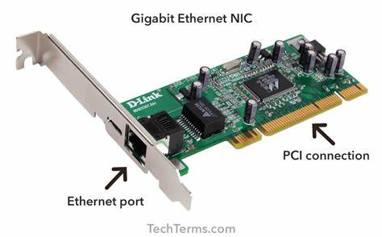
TOPIC
FUNCTION OF NETWORK INTERFACE CARD(NIC)

Slide 2
WHAT IS (NIC)?
Network interface card, also known as NIC or network interface controller, is typically a circuit board that installed on the computer to connect to the network. It works as an indispensable component for the network connection of computers. Currently, NIC cards designed as a built-in style are commonly found in most computers and some network servers. Besides, network cards like server network card can also be inserted into expansion slots of devices.

Slide 3
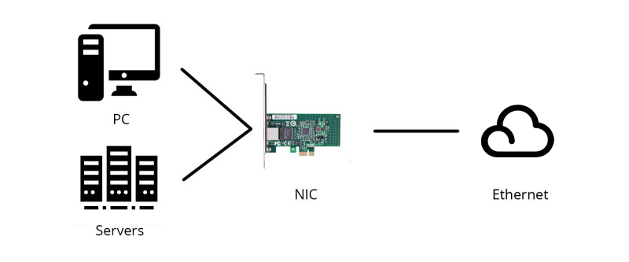
NETWORK INTERFACE CARD

Slide 4
NETWORK INTERFACE CARD
A network interface card (NIC) is a hardware component without which a computer cannot be connected over a network. It is a circuit board installed in a computer that provides a dedicated network connection to the computer. It is also called network interface controller, network adapter or LAN adapter.

Slide 5
Purpose
NIC allows both wired and wireless communications.
NIC allows communications between computers connected via local area network (LAN) as well as communications over large-scale network through Internet Protocol (IP).
NIC is both a physical layer and a data link layer device, i.e. it provides the necessary hardware circuitry so that the physical layer processes and some data link layer processes can run on it.

Slide 6
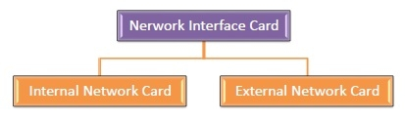
Types of NIC Cards
NIC cards are of two types

Slide 7
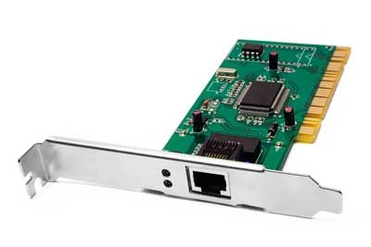
Internal Network Cards
In internal networks cards, motherboard has a slot for the network card where it can be inserted. It requires network cables to provide network access. Internal network cards are of two types. The first type uses Peripheral Component Interconnect (PCI) connection, while the second type uses Industry Standard Architecture (ISA).

Slide 8
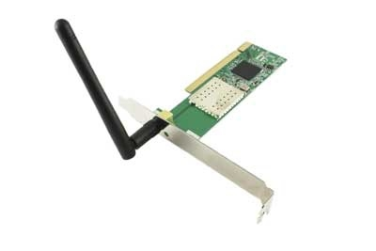
External Network Cards
In desktops and laptops that do not have an internal NIC, external NICs are used. External network cards are of two types: Wireless and USB based. Wireless network card needs to be inserted into the motherboard, however no network cable is required to connect to the network. They are useful while traveling or accessing a wireless signal.

Slide 9
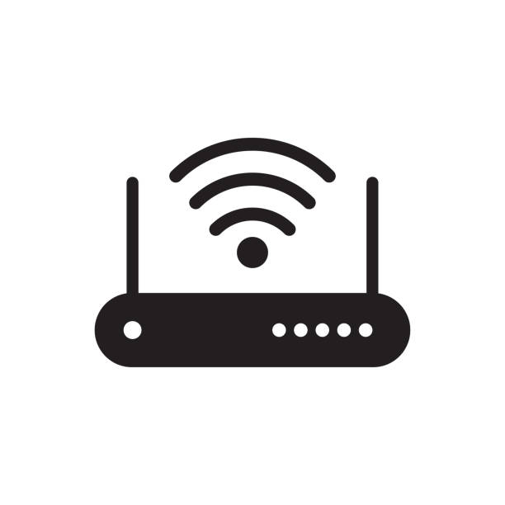
TOPIC
Repeater

Slide 10
What is Repeater ?
A repeater is a dynamic network device used to reproduce the signals when they transmit over a greater distance so that the signal’s strength remains equal. It can be used to create an Ethernet network. A repeater that occurs as the first layer of the OSI layer is the physical layer.

Slide 11
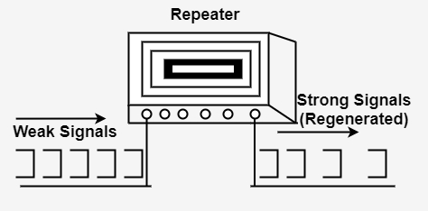
Repeater

Slide 12
Advantages of Repeater
The main advantages of repeaters are :-
The signals get weaker as they transit to greater distances. The repeater provides the stability of the signals.
These repeaters are cost-effective and easy to use.
The repeaters don’t influence network performance.
It is not all signals that can be linked using physical media.
These repeaters can retransmit the information and powerful the weak signals.

Slide 13
Disadvantage of Repeaters
The main disadvantages of repeaters are :-
They cannot connect two distinct networks.
While amplifying the signals, the repeaters also amplify the level of noise in those signals.
If we enhance the extent of the web by only using the repeaters. In that case, the signal propagation time will grow to a considerable level, and the network’s performance will collapse.

Slide 14
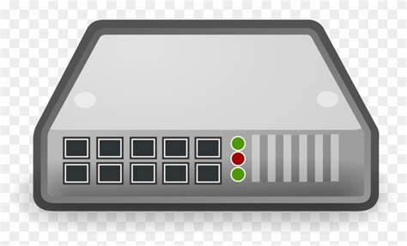
TOPIC
HUB

Slide 15
WHAT IS Hub ?
Hub is a networking device that is used to connect multiple devices in a network. Hub is also called repeater. It is a layer 1 device. Hub connects computers together for communication.
Hub is not an intelligent device as it cannot forward data based on logical and physical address. It works in Layer 1 (Physical Layer) of the OSI model. Hub has many ports. Hub sends data packets coming from any one port to all other ports. It depends on the receiving computer (port) to decide whether the packet is meant for him or not.

Slide 16
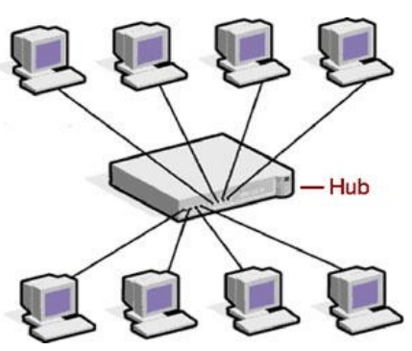
HUB

Slide 17
Working of Hub
Data packets in the hub are called frames. Whenever a port sends a frame, the hub forwards that frame to all ports.The hub does not even differentiate the type of frame, whether the frame is uni -cast, multicast or broadcast, the hub forwards all the frames to all the ports.

Slide 18
Types of Hub
Two type Hub
passive hub
active hub
1.Passive hub:- It forwards the signal in the same condition as it is, so it does not require power supply.
2.Active hub:- In this the signal is generated again, so it also acts like a repeater. These are called multiport repeater. It requires power supply.

Slide 19
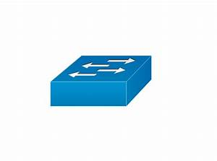
TOPIC
Switches

Slide 20
What is Switch
Switch is a networking device that connects network devices and segments. It is also called multiport bridge. Because its procedure is similar to that of bridge.
It works in Layer 2 (Data Link Layer) of the OSI model. But nowadays such switches have also come which work in layer 3 (network layer) of osi model.

Slide 21
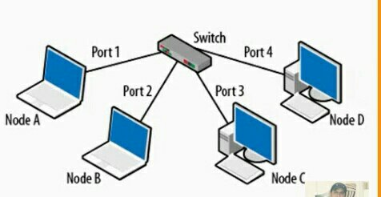
There are many ports in the switch, when the data comes through the switch, then the switch reads the address of the destination computer in the data and sends it to the destination computer. It checks the MAC address of the frame.

Slide 22
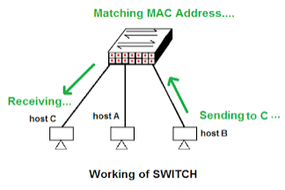
As you would know that Hubs work on half duplex communication so with Hubs you can either send data or only receive it. But this is not the case with switches, with switches you can send and receive data simultaneously.
Hubs represent a single collision domain, but switches have a separate collision domain for each port. It does not make any difference on other hosts.

Slide 23
Features of Switch
Its features are given below
It works on the data link layer of the OSI model.
It is an intelligent device
It uses MAC address to send data packets to destination ports.
It uses packet switching technology to receive and forward data
It supports unicast, multicast and broadcast communication.
Its transmission mode is full duplex.
Switch is active device.
The number of ports is more in this. – 24/48

Slide 24


